Slide 1

End to End Deep Learning for
Self Driving Car!
3546 – Deep Learning
School of Continuing Studies, University of Toronto
Presented by :
Konrad Korzeniewski
Ashish Gupta

Slide 2
Let the Journey Begin!
Business Case
Data Source and Visualizations
Sequential Modelling
Transfer Learning
Auto Encoders
Scope for Better Simulation
Final Predictions

Slide 3
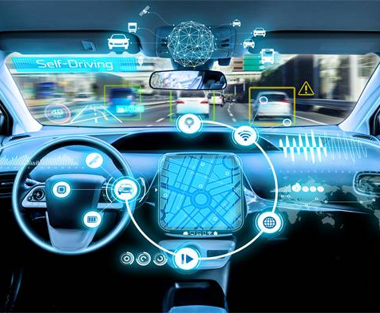
BUSINESS
C A S E
End to End Learning for Self Driving Cars
https://arxiv.org/pdf/1604.07316v1.pdf
Self Driving Car Steering Angle Prediction based on Image Recognition (Auto Encoders)
http://cs231n.stanford.edu/reports/2017/pdfs/626.pdf
Predict the angle of the driving wheel

Slide 4


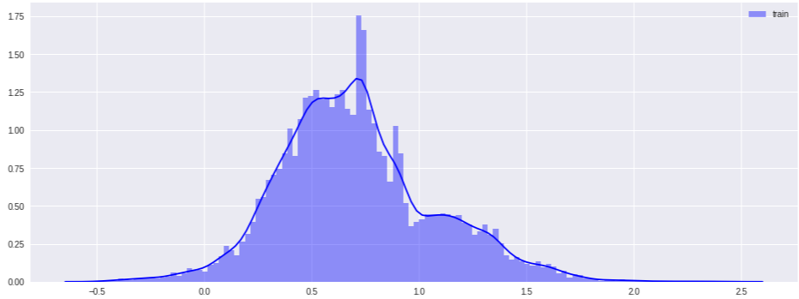
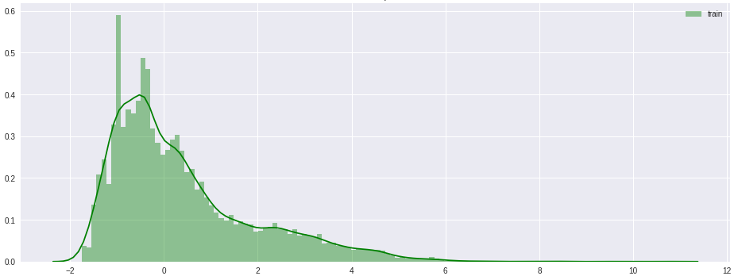
DATA SOURCE
V I S U A L I Z A T I O N S
Sully Chen GitHub Repo
X - 15100 Images 100 x 100 px
Y - 15100 Steering Wheel angles
https://github.com/SullyChen/driving-datasets
Skewness Distribution
Kurtosis Distribution
https://github.com/RoyMachineLearning/Deep-Learning-Self-Driving-Simulator

Slide 5
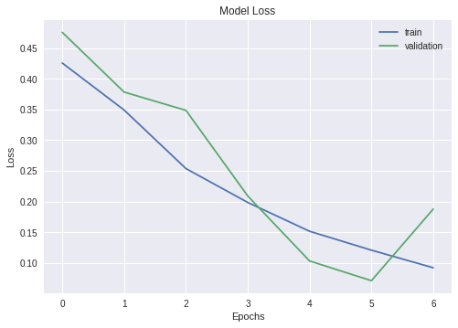

SEQUENTIAL
Validation Loss : 0.0701
M O D E L
Convolutional 2-D Layers
Dense Layers
Batch Normalization
Max Pooling
Drop Out
https://github.com/RoyMachineLearning/Deep-Learning-Self-Driving-Simulator

Slide 6
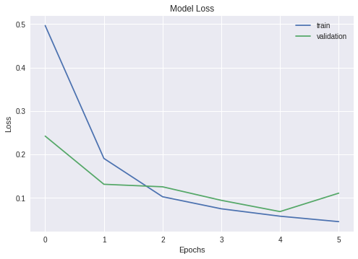

TRANSFER
L E A R N I N G
Validation Loss : 0.0686
Xception Model
Dense Layers
Drop Out
https://github.com/RoyMachineLearning/Deep-Learning-Self-Driving-Simulator

Slide 7
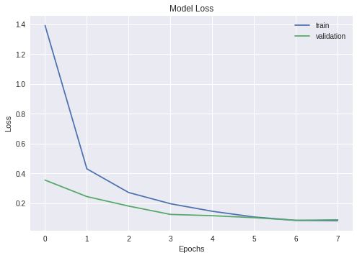
A U T O E N C O D E R
M O D E L
Validation Loss : 0.0851
Convolutional 2-D Layers
Batch Normalization
Max Pooling
/ Up Sampling
Dense Layers
Drop Out
https://github.com/RoyMachineLearning/Deep-Learning-Self-Driving-Simulator

Slide 8
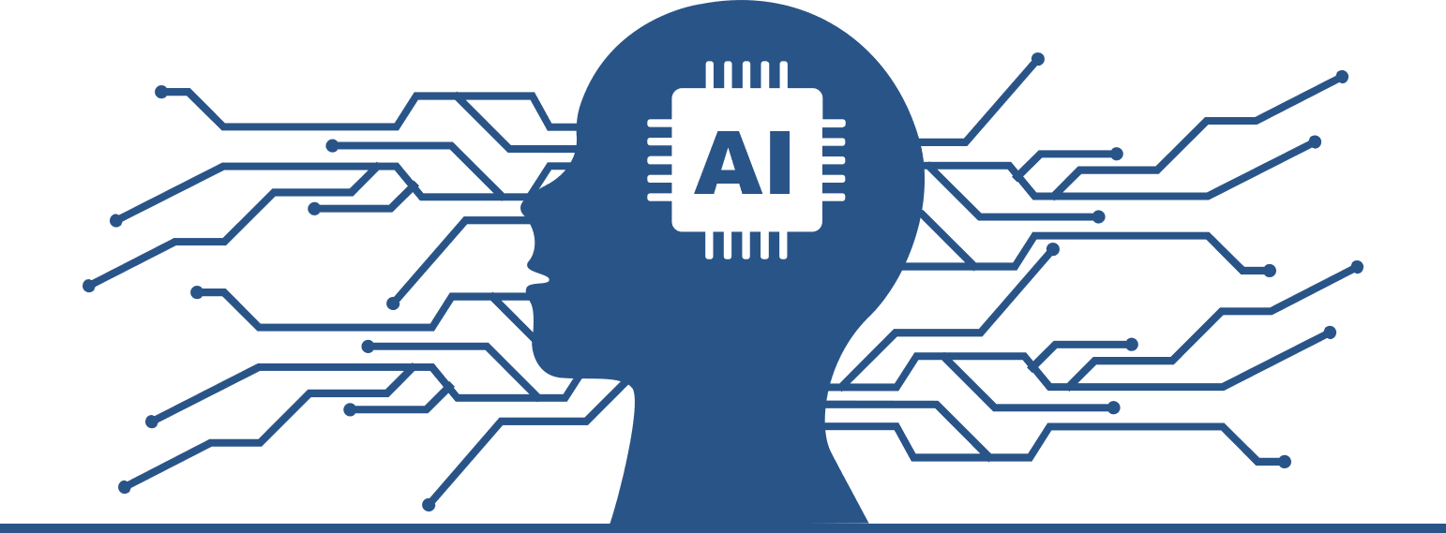
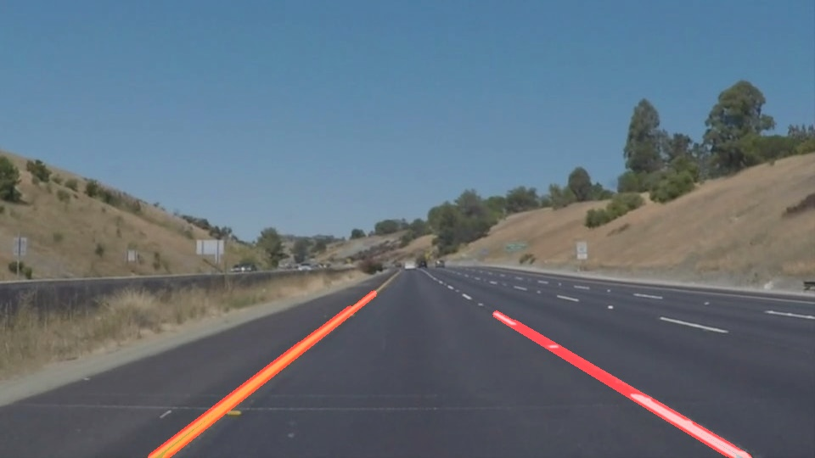
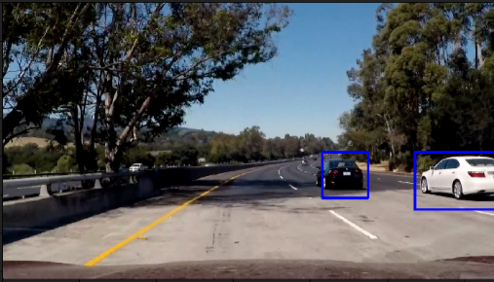
S C O P E F O R
S I M U L A T I O N S
Lane Detection
Object Detection
https://github.com/RoyMachineLearning/Deep-Learning-Self-Driving-Simulator

Slide 9
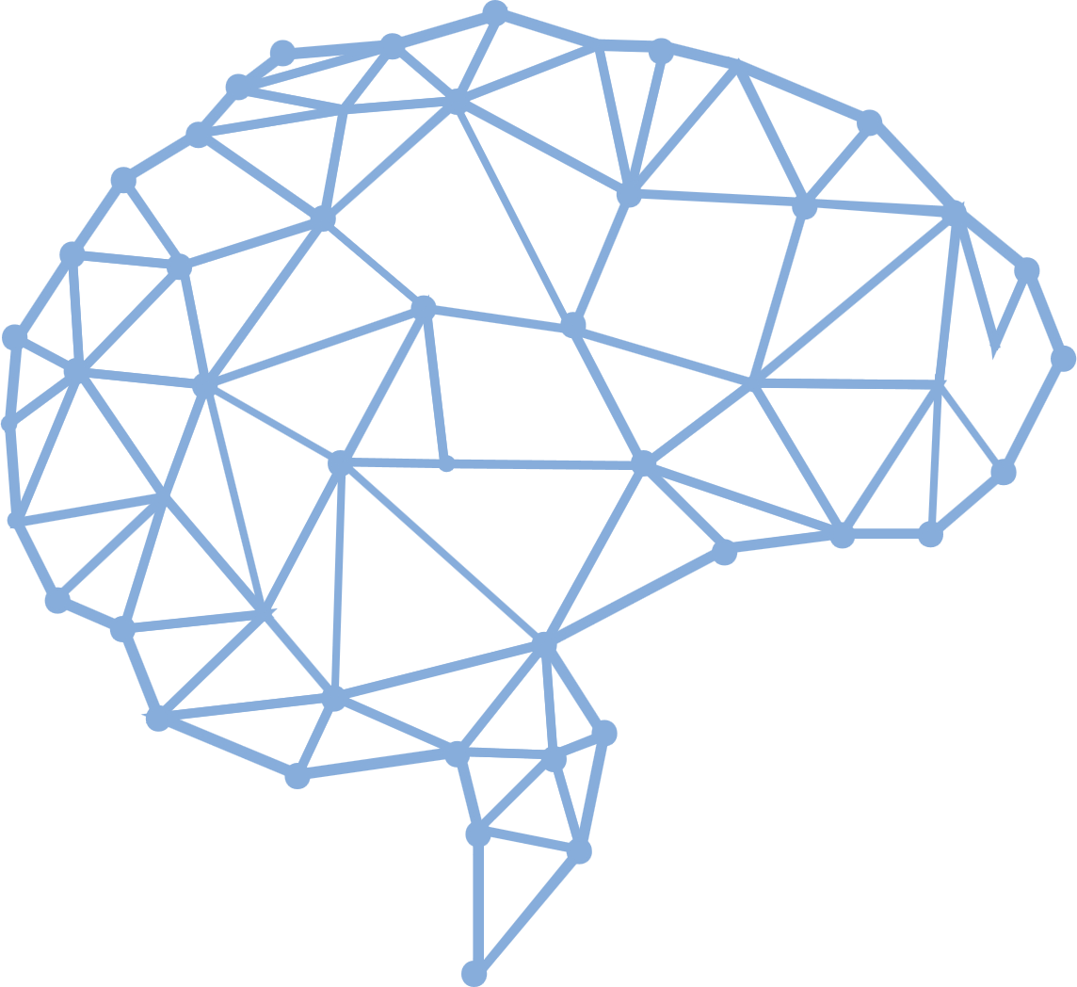
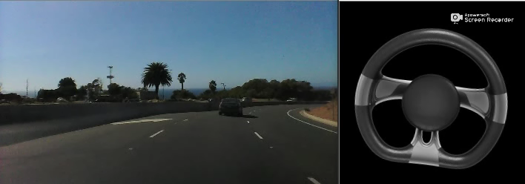
F I N A L
P R E D I C T I O N S
ITS SHOW TIME!!
https://github.com/RoyMachineLearning/Deep-Learning-Self-Driving-Simulator

Slide 10
Thank You
for bearing us……

Slide 11
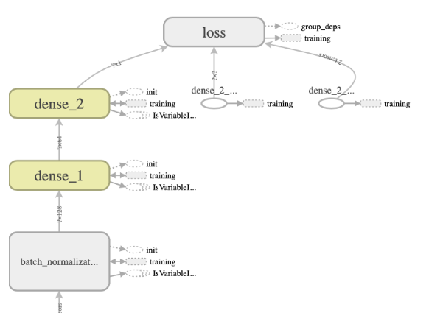
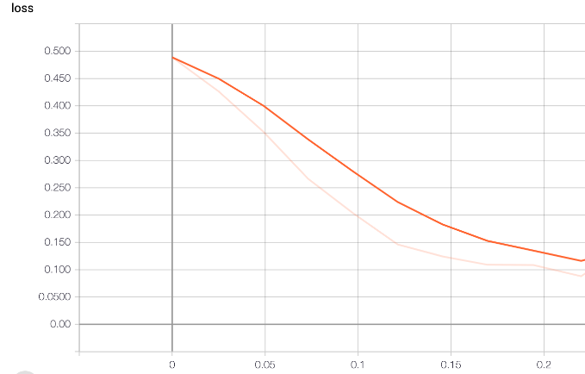
A P P E N D I X
T E N S O R B O A R D
https://github.com/RoyMachineLearning/Deep-Learning-Self-Driving-Simulator
Notes:
You can also mention about Main graph and the activation function.

Slide 12

I N S P I R A T I O N S
Research paper: End to End Learning for Self-Driving Cars by Nvidia. [https://arxiv.org/pdf/1604.07316.pdf]
Self Driving Car Steering Angle Prediction based on Image Recognition by Stanford. [http://cs231n.stanford.edu/reports/2017/pdfs/626.pdf]
https://github.com/SullyChen/Autopilot-TensorFlow
https://github.com/cyanamous/Self-Driving-Car-
https://github.com/akshaybahadur21/Autopilot
Nvidia blog:
https://devblogs.nvidia.com/deep-learning-self-driving-cars/
https://github.com/RoyMachineLearning/Deep-Learning-Self-Driving-Simulator

